Slide 1
Chicago RideShare Provider Fare Predictor
def machine_learning-project_3(team): team = [“max patterson”, “peter sulzen”, “anastasios tomazos”,
“erin wills”]
https://chi-ride.herokuapp.com
atomazos/machine_learning-ridesharing_data

Slide 2
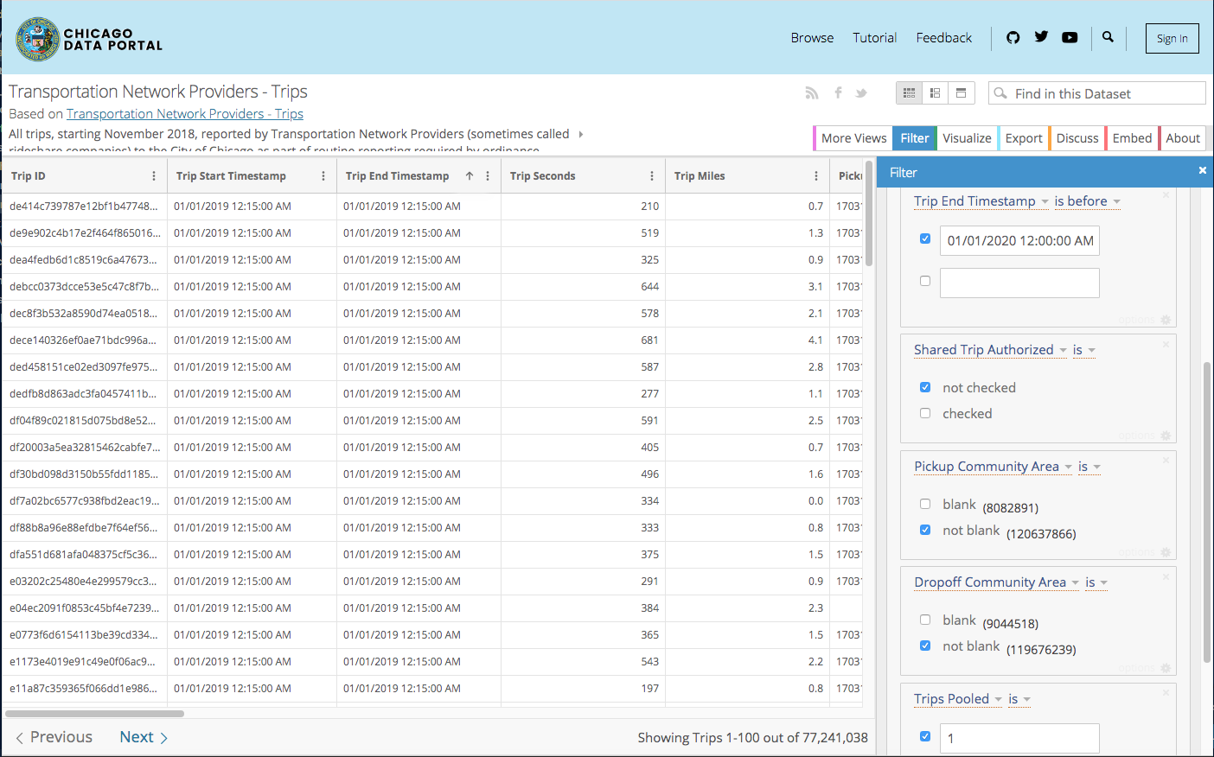
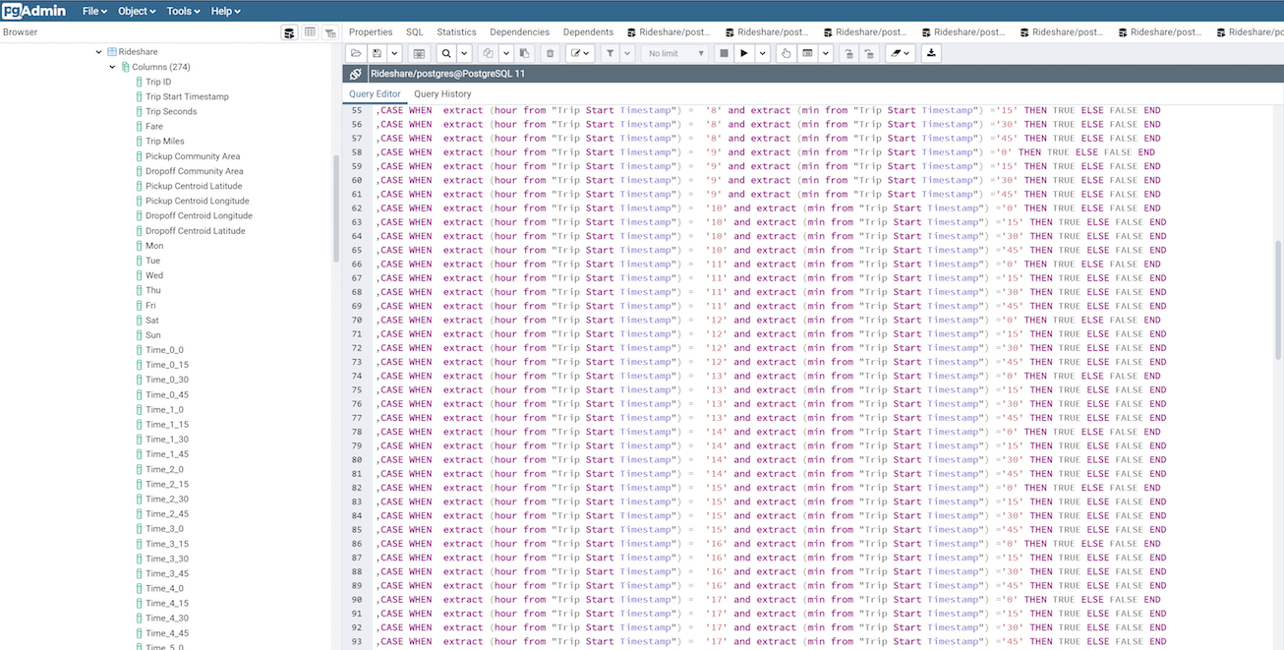
Data Source, Databases, Data Wrangling

Slide 3
Data Source, Database, Data Wrangling: the backend
1,200,000
rows
Trip Seconds
Trip Miles
Pickup Community Area
Dropoff Community Area
Pickup Centroid Latitude
Pickup Centroid Longitude
Dropoff Centroid Longitude
Dropoff Centroid Latitude
Mon
Tue
Wed
Thu
Fri
Sat
Sun
January
February
March
April
May
June
July
August
September
October
November
December
rain_1h
temp
feels_like
pressure
humidity
snow_1h
Time_0_0
Time_0_15
Time_0_30
Time_0_45
Time_1_0
Time_1_15
Time_1_30
Time_1_45
Time_2_0
Time_2_15
Time_2_30
Time_2_45
Time_3_0
Time_3_15
Time_3_30
Time_3_45
Time_4_0
Time_4_15
Time_4_30
Time_4_45
Time_5_0
Time_5_15
Time_5_30
Time_5_45
Time_6_0
Time_6_15
Time_6_30
Time_6_45
Time_7_0
Time_7_15
Time_7_30
Time_7_45
Time_8_0
Time_8_15
Time_8_30
Time_8_45
Time_9_0
Time_9_15
Time_9_30
Time_9_45
Time_10_0
Time_10_15
Time_10_30
Time_10_45
Time_11_0
Time_11_15
Time_11_30
Time_11_45
Time_12_0
Time_12_15
Time_12_30
Time_12_45
Time_13_0
Time_13_15
Time_13_30
Time_13_45
Time_14_0
Time_14_15
Time_14_30
Time_14_45
Time_15_0
Time_15_15
Time_15_30
Time_15_45
Time_16_0
Time_16_15
Time_16_30
Time_16_45
Time_17_0
Time_17_15
Time_17_30
Time_17_45
Time_18_0
Time_18_15
Time_18_30
Time_18_45
Time_19_0
Time_19_15
Time_19_30
Time_19_45
Time_20_0
Time_20_15
Time_20_30
Time_20_45
Time_21_0
Time_21_15
Time_21_30
Time_21_45
Time_22_0
Time_22_15
Time_22_30
Time_22_45
Time_23_0
Time_23_15
Time_23_30
Time_23_45
PCA_1
PCA_2
PCA_3
PCA_4
PCA_5
PCA_6
PCA_7
PCA_8
PCA_9
PCA_10
PCA_11
PCA_12
PCA_13
PCA_14
PCA_15
PCA_16
PCA_17
PCA_18
PCA_19
PCA_20
PCA_21
PCA_22
PCA_23
PCA_24
PCA_25
PCA_26
PCA_27
PCA_28
PCA_29
PCA_30
PCA_31
PCA_32
PCA_33
PCA_34
PCA_35
PCA_36
PCA_37
PCA_38
PCA_39
PCA_40
PCA_41
PCA_42
PCA_43
PCA_44
PCA_45
PCA_46
PCA_47
PCA_48
PCA_49
PCA_50
PCA_51
PCA_52
PCA_53
PCA_54
PCA_55
PCA_56
PCA_57
PCA_58
PCA_59
PCA_60
PCA_61
PCA_62
PCA_63
PCA_64
PCA_65
PCA_66
PCA_67
PCA_68
PCA_69
PCA_70
PCA_71
PCA_72
PCA_73 PCA_74
PCA_75
PCA_76
PCA_77
DCA_1
DCA_2
DCA_3
DCA_4
DCA_5
DCA_6
DCA_7
DCA_8
DCA_9
DCA_10
DCA_11
DCA_12
DCA_13
DCA_14
DCA_15
DCA_16
DCA_17
DCA_18
DCA_19
DCA_20
DCA_21
DCA_22
DCA_23
DCA_24
DCA_25
DCA_26
DCA_27
DCA_28
DCA_29
DCA_30
DCA_31
DCA_32
DCA_33
DCA_34
DCA_35
DCA_36
DCA_37
DCA_38
DCA_39
DCA_40
DCA_41
DCA_42
DCA_43
DCA_44
DCA_45
DCA_46
DCA_47
DCA_48
DCA_49
DCA_50
DCA_51
DCA_52
DCA_53
DCA_54
DCA_55
DCA_56
DCA_57
DCA_58
DCA_59
DCA_60
DCA_61
DCA_62
DCA_63
DCA_64
DCA_65
DCA_66
DCA_67
DCA_68
DCA_69
DCA_70
DCA_71
DCA_72
DCA_73
DCA_74
DCA_75
DCA_76
DCA_77
features:
8 original, unaltered
19 days of week & month features added
6 weather features added via
API
260 Label/Hot Encoding features wrangled
target: “Fare”

Slide 4
Machine Learning : Model process
Generate Hypothesis:
Data understanding
Preprocessing Data:
Data cleaning/
Data munging (incl., parsing dtypes,
“one-hot encoding”, dropna(),
Boolean replace, X.shape/Y.shape)
Train Model:
SGD Linear
MinMaxScalar()
Feature Engineering:
Coefficients
Hypertune Model:
GridSearchCV
Test Model
Estimator Selection:
Stochastic Gradient Descent (SDG)
Improve Model
Evaluate Model
:

Slide 5
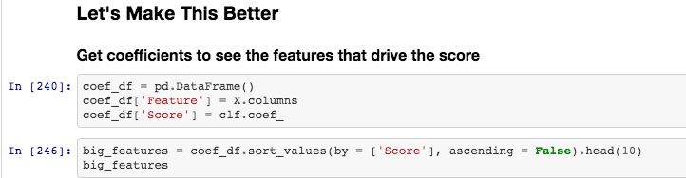
Machine Learning: Coefficients
Trip Seconds
Trip Miles
Pickup Community Area
Dropoff Community Area
Pickup Centroid Latitude
Pickup Centroid Longitude
Dropoff Centroid Longitude
Dropoff Centroid Latitude
Mon
Tue
Wed
Thu
Fri
Sat
Sun
January
February
March
April
May
June
July
August
September
October
November
December
temp
feels_like
pressure
humidity
rain_1h
snow_1h
Time_0_0
Time_0_15
Time_0_30
PCA_56
PCA_57
PCA_58
PCA_59
PCA_60
PCA_61
PCA_62
PCA_63
PCA_64
PCA_65
PCA_66
PCA_67
PCA_68
PCA_69
PCA_70
PCA_71
PCA_72
PCA_73
PCA_74
PCA_75
PCA_76
PCA_77
DCA_1
DCA_2
DCA_3
DCA_4
DCA_5
DCA_6
DCA_7
DCA_8
DCA_9
DCA_10
DCA_11
DCA_12
DCA_13
DCA_14
DCA_15
DCA_53
DCA_54
DCA_55
DCA_56
DCA_57
DCA_58
DCA_59
DCA_60
DCA_61
DCA_62
DCA_63
DCA_64
DCA_65
DCA_66
DCA_67
DCA_68
DCA_69
DCA_70
DCA_71
DCA_72
DCA_73
DCA_74
DCA_75
DCA_76
DCA_77
Score
131.672167
126.725549
4.473224
4.269339
3.826559
3.75917
2.925234
2.270233
2.036524
1.999306
Trip Seconds
Trip Miles
rain_1h
PCA_76
DCA_76
temp
November
PCA_56
DCA_56
snow_1h
{
O’Hare
{
Midway

Slide 6
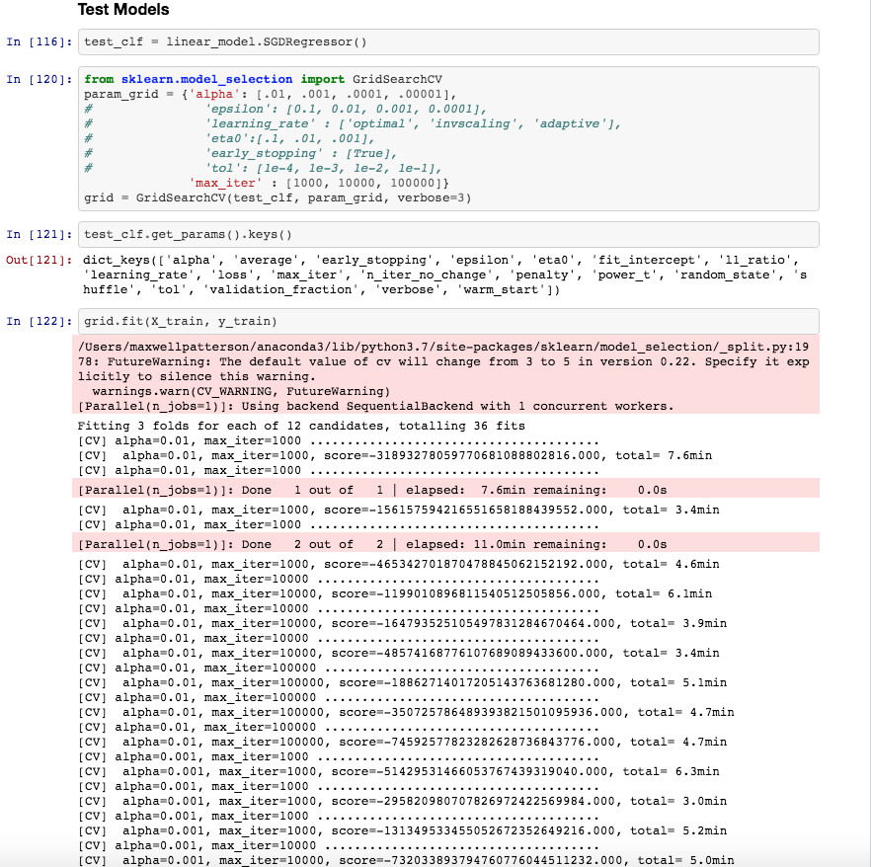
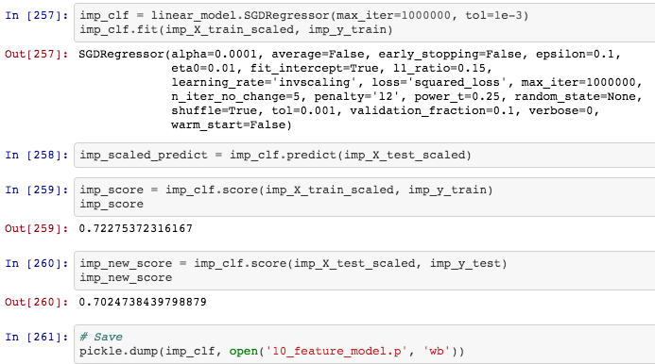
Machine Learning: Test and Improve Model
Improve Models

Slide 7
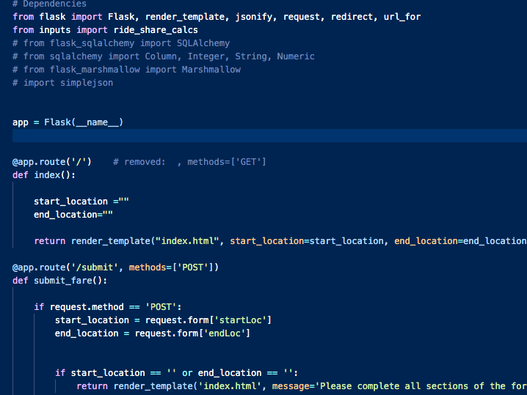
Development; Deployment

Slide 8
Development; Deployment: the front end
https://chi-ride.herokuapp.com

Slide 9
Chicago RideShare Provider Fare Predictor
Congratulations
Data Science Bootcamp
Grads!
def machine_learning-project_3(team): team = [“max patterson”, “peter sulzen”, “anastasios tomazos”,
“erin wills”]
https://chi-ride.herokuapp.com
atomazos/machine_learning-ridesharing_data

